Slide 1

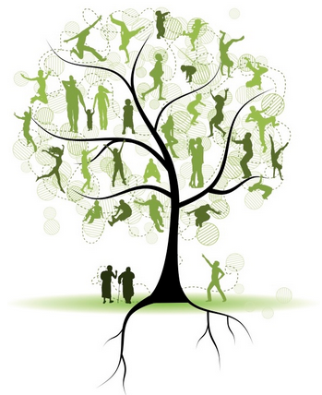

RootsTech Family Tree
System Prototype Presentation and Demonstration
Group 1
(Kathleen Deboer, Jean-Marc Julien, Kristen Kangas, Jet Her, and Jeremy Rice)

Slide 2

Overview
Key Requirements
System Architecture Diagram
Strengths and Weaknesses
Demonstration

Slide 3
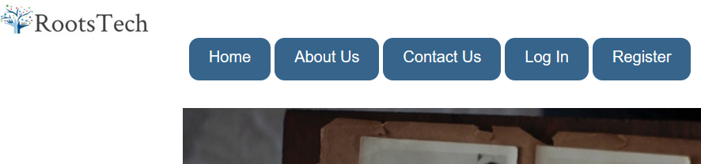
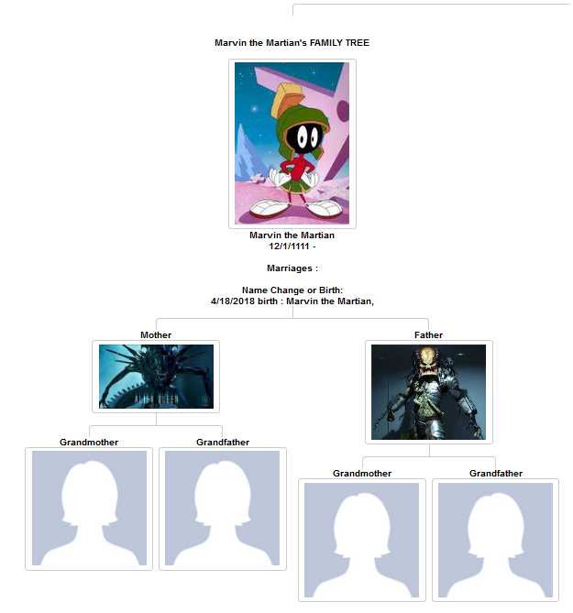
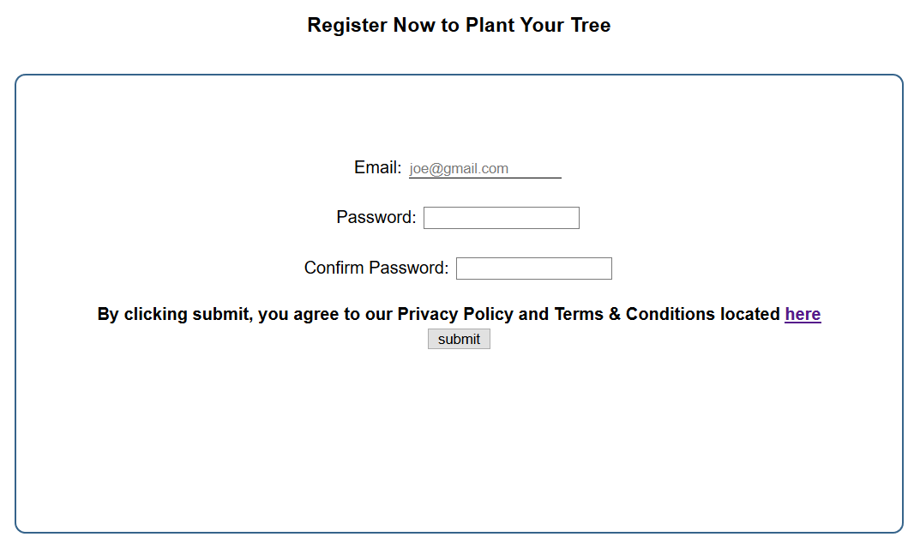
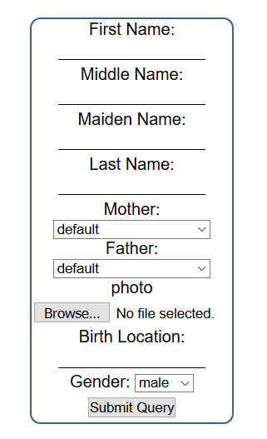
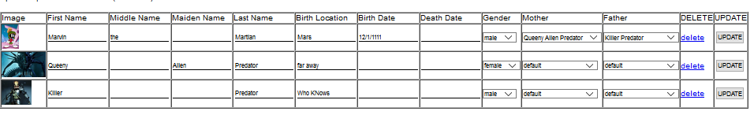
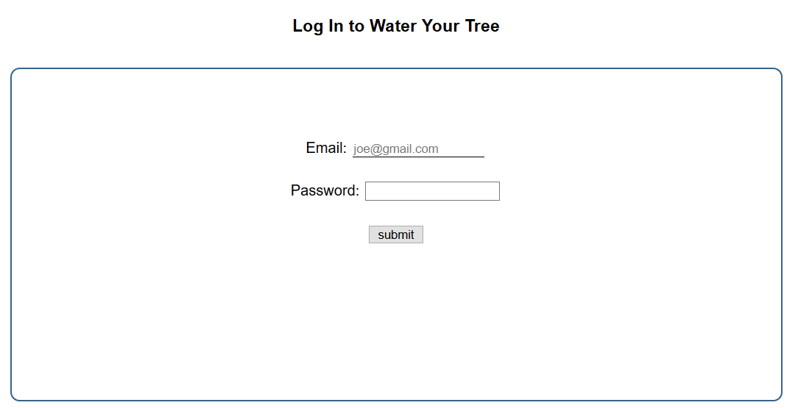
Key Requirement
Customer user account to register and sign up.
A family tree populator
A tree interface
Ability to upload attachments
A login
Security
Web based access

Slide 4
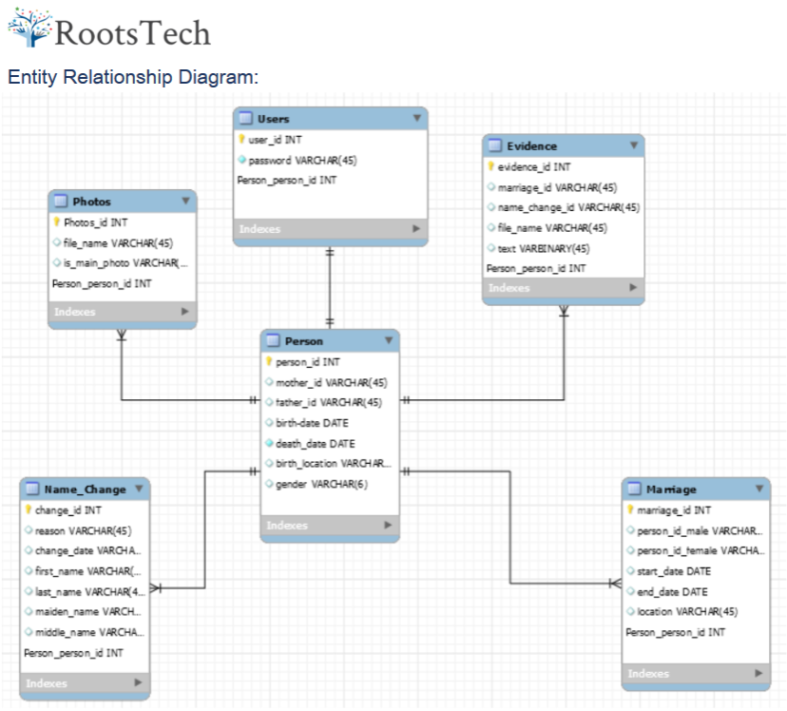
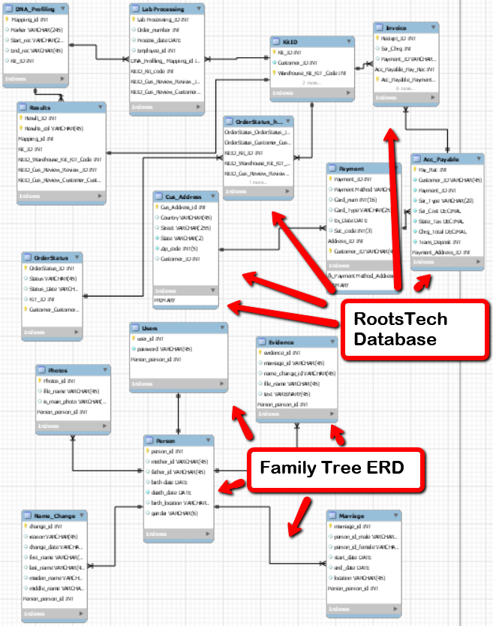
Entity Relationship Diagram (ERD)

Slide 5


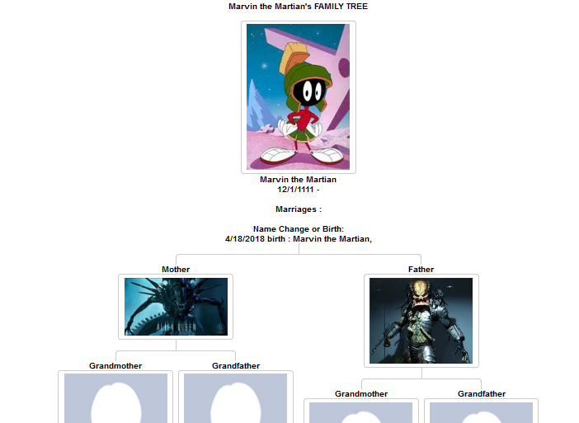

Strengths and Weaknesses
Strengths
Weaknesses
Design and Style
Security (SHA-256)
Familiarity
Competition
Continued Testing Required

